Slide 1
NIFTY 50 Bank Stock Price Prediction

Slide 2
Problem Statement
Forecast future bank stock prices for investment insights.

Slide 3
Objective
Predict next 30 days using Prophet and provide an interactive dashboard.

Slide 4
Dataset
Historical NIFTY Bank stock price dataset (banknifty.csv).

Slide 5
Technologies
Python, Pandas, Prophet, Streamlit, Plotly, Joblib

Slide 6
Methodology
Data preprocessing
Train Prophet models
Generate future dataframe
Predict 30 days
Visualize and export CSV

Slide 7
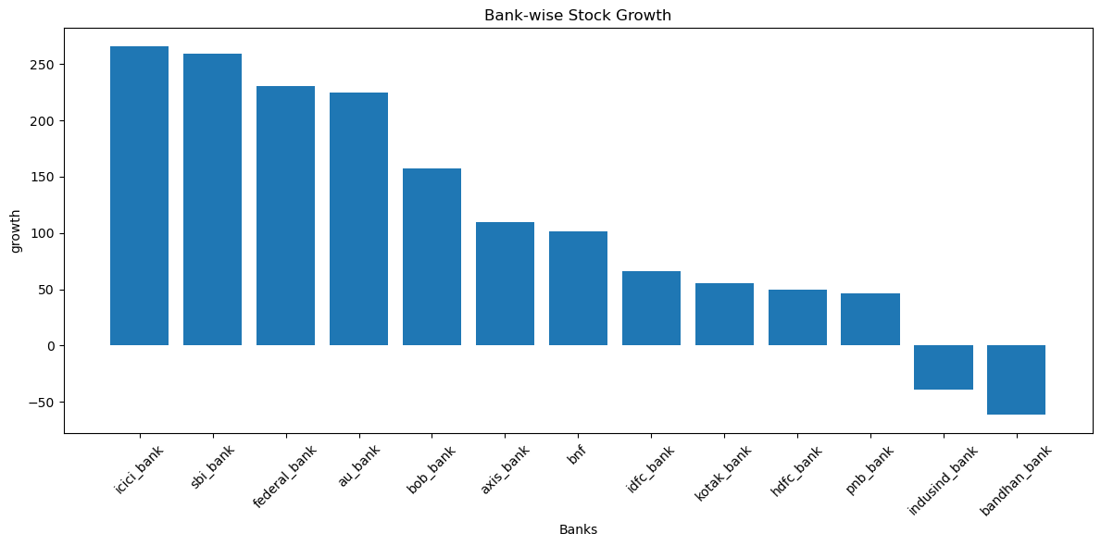
Exploratory Data Analysis - Bank-wise Stock Growth
From this we know that ICICI bank is best performer and bandhan_bank is worst performer.

Slide 8
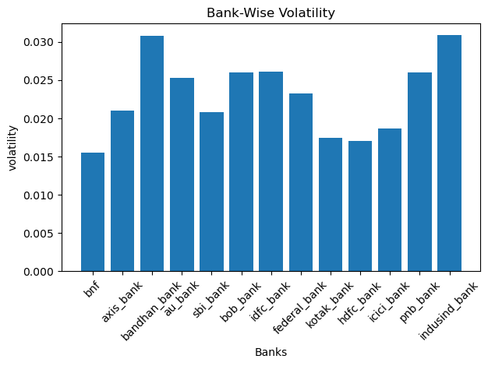
Bank-Wise Volatility
#indusind bank have high volatility and bnf bank have low volatility

Slide 9
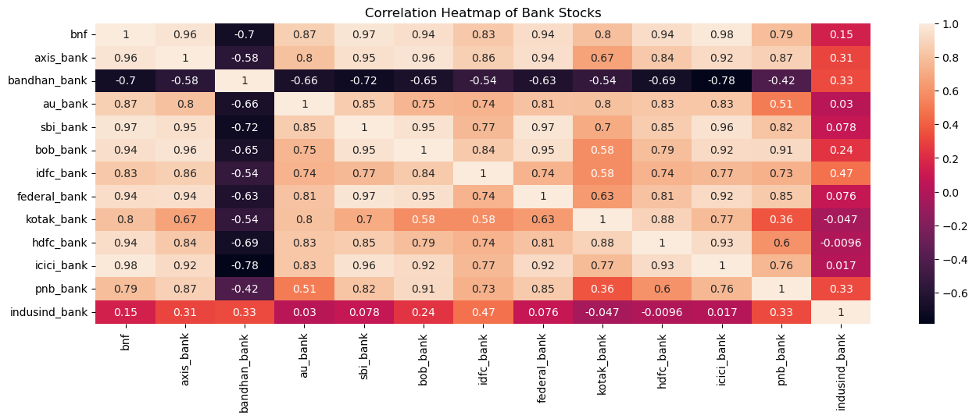
Correlation Heatmap

Slide 10
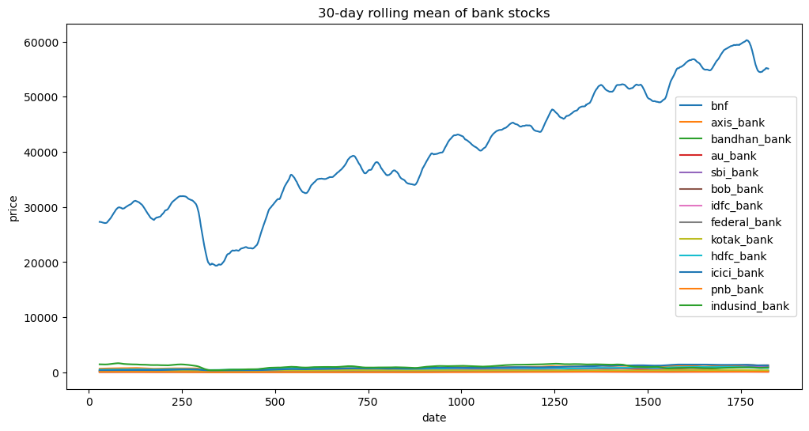
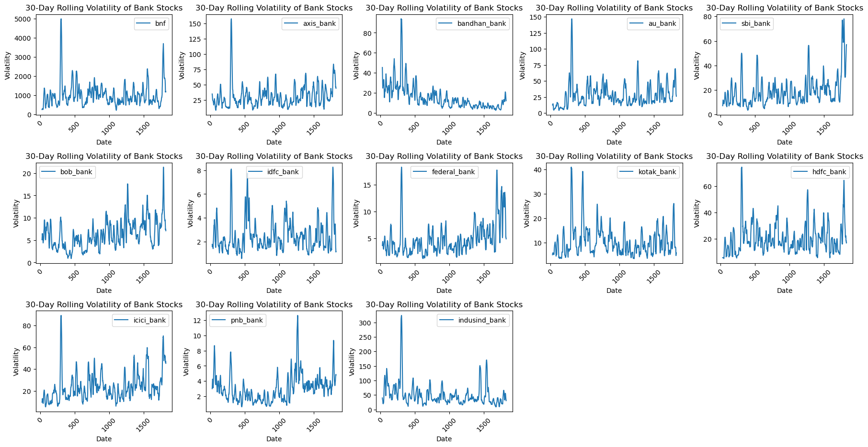
Historical Trend Analysis-30 day rolling mean
30-Day Rolling Volatility

Slide 11
Application
Users choose a bank, view forecast, components and download results.

Slide 12
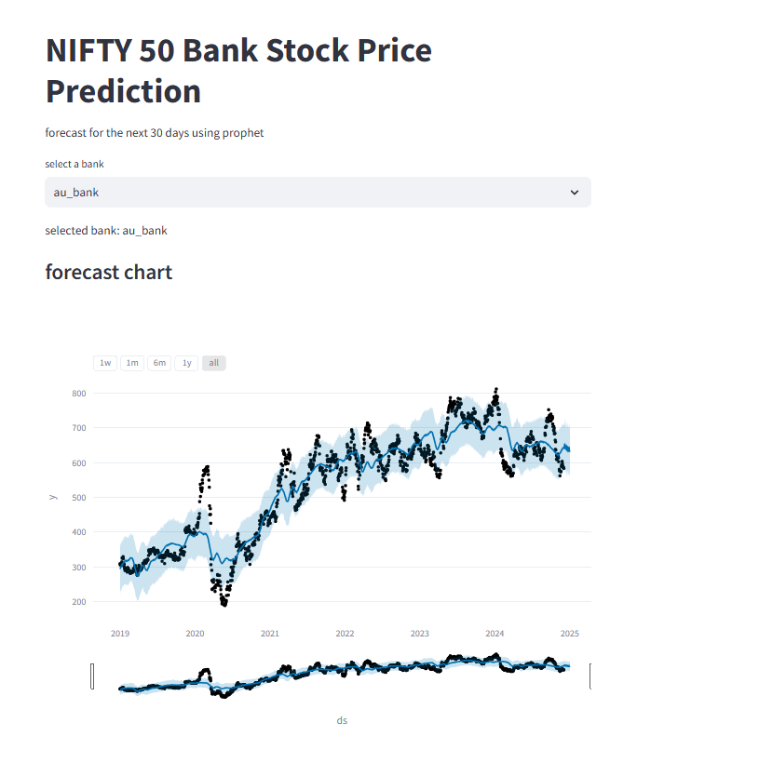
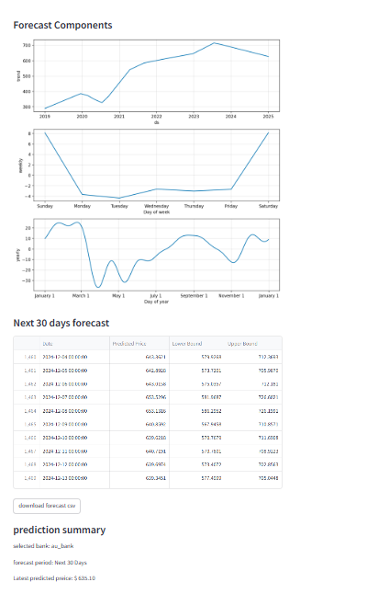
Results
Interactive forecast visualization and downloadable predictions.

Slide 13
Future Scope
Live API integration
Model comparison
Improved accuracy

Slide 14
Thank You
Thank you for giving me the opportunity
to present my project.

